Slide 1
DAT - Class 2
Working With Git/Command Line, Python Fundamentals

Slide 2
Class Introduction
Overview
Take 10-15 Minutes to get introductions, assess people on basic assumptions about Data Science

Slide 3
Suggested Agenda
Time | Activity | Purpose
0:00 - 0:02 | Welcome | Introduce the lesson’s objectives and agenda.
0:02 - 0:10 | Activity 1 | Why?
0:10 - 0:25 | Activity 2 | Why?
0:25 - 0:30 | Summary | Wrap up the learning and share next steps.

Slide 4
Materials and Preparation
This is something instructors will need to do in advance of delivering this lesson.
This is something they’ll need to gather or provide.
This is some other important information they should know about in advance.
Be sure to link to any student-facing materials needed for this lesson on this slide.

Slide 5
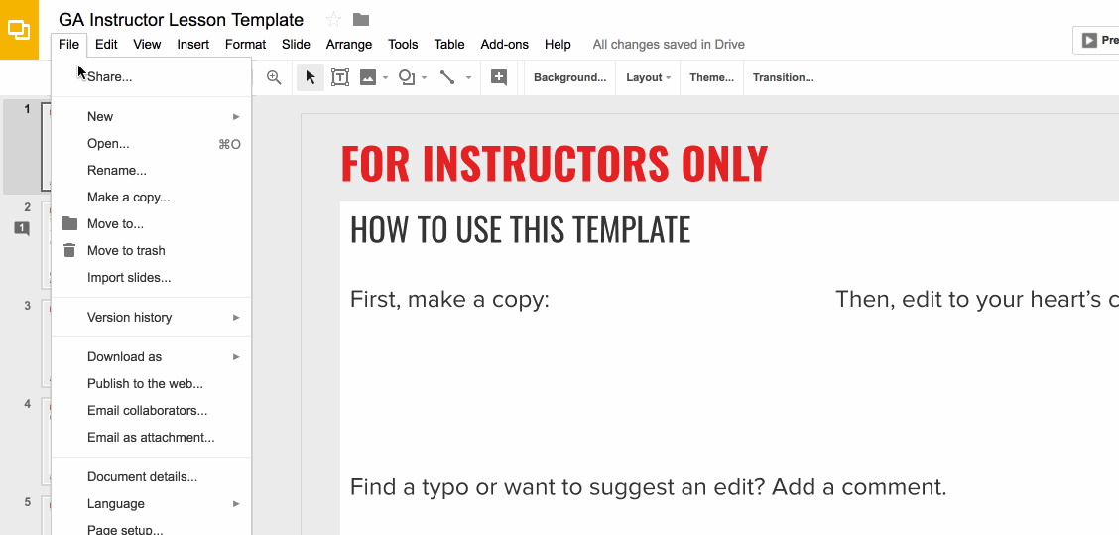
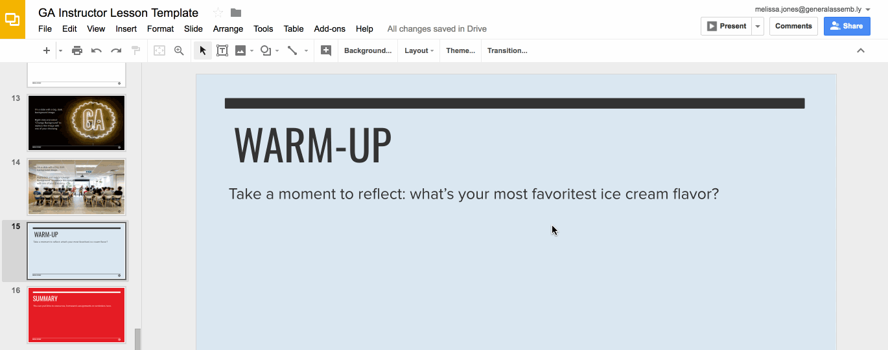
Preparation (Continued)
Ready to customize this lesson?
First things first, make a copy of this presentation. You’ll then be able to edit to your 💗’s content.
Find a typo or want to suggest an edit?
Add a comment. Our Product Advisory Board will review and incorporate your suggestions.

Slide 6
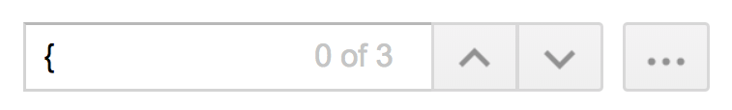
Preparation (Continued)
Remember to press Command F and do a search for instances of brackets in the deck. All instances of brackets denote places where instructors must fill in information/customize prior to presenting in class.

Slide 7
Differentiation and Extensions
This is a suggestion for a way in which instructors might change up this lesson to meet the needs of more advanced or less advanced students.
This is another suggestion.
This is another suggestion.
Be sure to link to any supplemental/optional materials on this slide.

Slide 8
Unit 1:
GA DAT 06/24
Lesson 1: Intro to Data Science
Lesson 2: Command Line/Git, Python Fundamentals
Lesson 3: Python Fundamentals
Lesson 4: Discretionary, but emphasis on Python familiarity

Slide 9
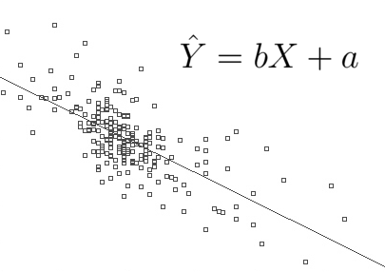
Python Fundamentals
By Next Class:
Primary data types
Control statements
Loops
By Class After That:
Functions & Classes
Optional Homework Will Be Assigned For Those That Need It
Notes:
3-5 minutes
TALKING POINTS
Take a minute or two to discuss importance of each of these concepts

Slide 10
The Command Line

Slide 11
Command Line
What was used to navigate computers befure GUI’s were adopted
Not very user-friendly, but easy to acclimate to after some experience
Use the same 5-6 commands over and over again
Notes:
3-5 minutes
TALKING POINTS
Take a minute or two to discuss importance of each of these concepts

Slide 12
Command Line
Command for…. | MAC | Windows
Listing current directory | pwd | cd
Changing directories | cd | cd
Listing contents of directory | ls | dir
Making a new one | mkdir | mkdir
Notes:
3-5 minutes
TALKING POINTS
Take a minute or two to discuss importance of each of these concepts

Slide 13
Working With The Command Line
Take 5-10 Minutes, and Do the Following:
Make a new folder(with the command line), and save a file to it (any file)
Navigate to that folder, and open it up by typing in the file name (with the file extension)
Practice navigating to different directories

Slide 14
Version Control

Slide 15

Git:
Primary way of tracking progress within a project
Also known as version control
Invented by Linus Torvalds -- King of the Nerds
Notes:
3-5 minutes
TALKING POINTS
Take a minute or two to discuss importance of each of these concepts

Slide 16
Most Common Commands
Command | What It Does
git clone | Copy git repository to your local hard drive
git add | Tracks changes to your working git repository
git pull | Downloads changes made to a remote directory to local one
git push | Adds changes from local directory to remote one
git commit | Adds changes to your git file
Notes:
3-5 minutes
TALKING POINTS
Take a minute or two to discuss importance of each of these concepts

Slide 17
Cloning the Class Repository
Do the following:
Using the command line, navigate to where you would like to import the class repository
Type in this line: git clone https://github.com/JonathanBechtel/DAT-06-24.git

Slide 18
Working With Your Own Repository
Take 5-10 Minutes And Do the Following:
Modify the readme.md file in your repo on github.com, and use a pull request to bring in the changes
Make changes to your own notebook, and push the changes to your github repo

Slide 19
Python Fundamentals

Slide 20
Data Science Overview
Overview
Spend about 20 minutes or so on the slides, walk through them carefully, and when you’re finished with this section……...GO INTO THE JUPYTER NOTEBOOK.
Wrap up the section on Pandas, and take a 5-10 minute break.

Slide 21

What is Python
Created by Guido Van Rossum in 1991
Emphasizes productivity and code readability
Easy to pick up and learn
Easier for many to contribute to production level code
Readable code means that almost anyone can read and understand what code is doing
Very active ecosystem, making it easy to get started with different projects
Notes:
2 MINUTES
TALKING POINTS
Focus on the bolded items
TEACHING TIPS
Goal is to show Python is not a fad, and based on strong fundamentals

Slide 22
Key Aspects of Python
Dynamically Typed
Variables are evaluated on the fly
Can be changed throughout the program
Strongly Typed
Doesn’t do (too much) type conversion when you evaluate expressions
Object Oriented
Allows you to bundle code & data together in one package to use throughout a program
Notes:
2 MINUTES
TALKING POINTS
Focus on the bolded items
TEACHING TIPS
Goal is to show Python is not a fad, and based on strong fundamentals

